Slide 1
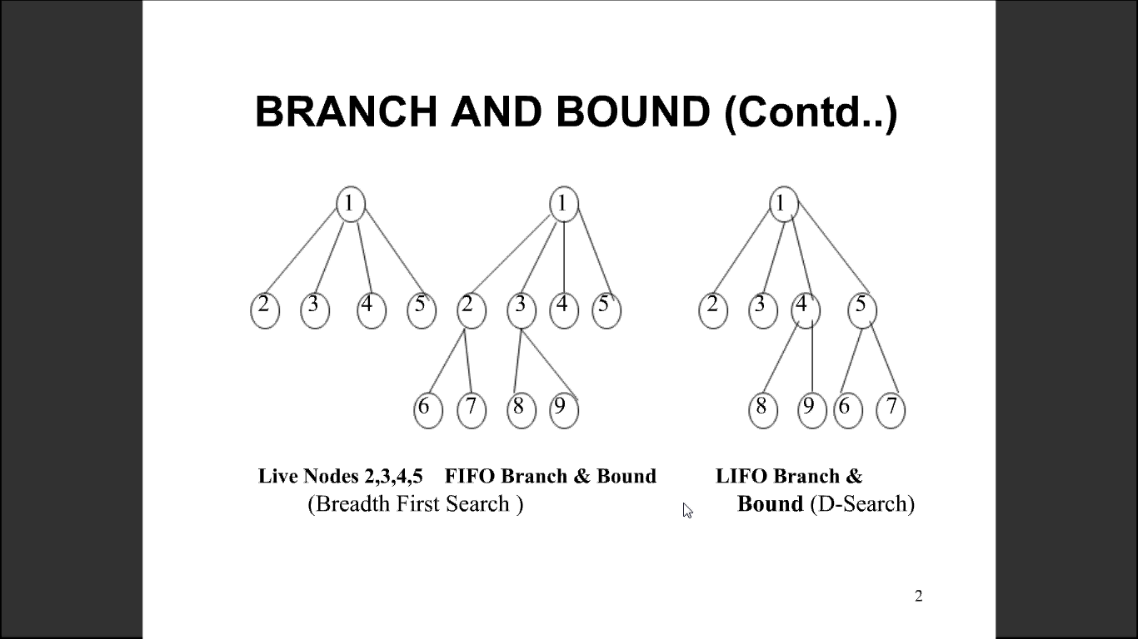
Branch & Bound
Branch and Bound is a state space search method in which all the children of a node are generated before expanding any of its children.

Slide 2
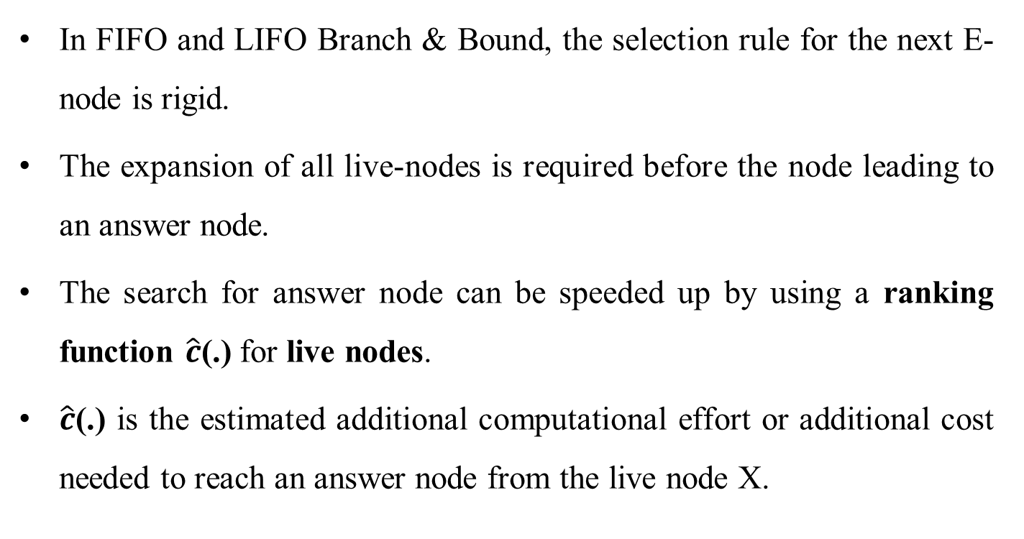
LC-Search
In FIFO and LIFO Branch & Bound, the selection rule for the next E-node is rigid.
The expansion of all live-nodes is required before the node leading to an answer node.
The search for answer node can be speeded up by using a ranking function $\hat{c}$(.) for live nodes.
$\hat{c}$(.) is the estimated additional computational effort or additional cost needed to reach an answer node from the live node X.

Slide 3
LC-Search (Contd..)
The cost (of node X ) could be
1. The number of nodes in the sub tree that need to be generated before an answer node is generated ( or )
2. The number of levels the nearest answer node is from X.
If cost measure 1 is used then the search would always generate the minimum number of nodes every Branch & Bound algorithm must generate.
If cost measure 2 is used then the only nodes to become E-nodes are the nodes on the path from the root to the nearest answer node.

Slide 4
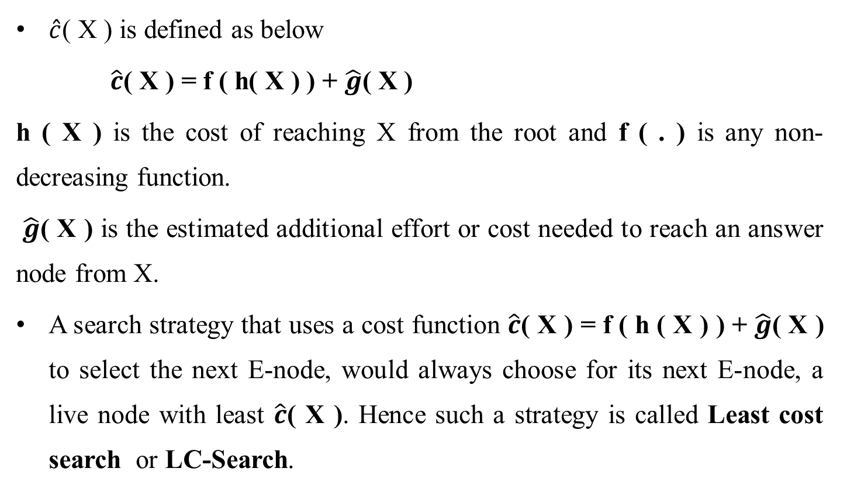
LC-Search (Contd..)
$\hat{c}$( X ) is defined as below
$\hat{c}$( X ) = f ( h( X ) ) + $\hat{g}$( X )
h ( X ) is the cost of reaching X from the root and f ( . ) is any non-decreasing function.
$\hat{g}$( X ) is the estimated additional effort or cost needed to reach an answer node from X.
A search strategy that uses a cost function $\hat{c}$( X ) = f ( h ( X ) ) + $\hat{g}$( X ) to select the next E-node, would always choose for its next E-node, a live node with least $\hat{c}$( X ). Hence such a strategy is called Least cost search or LC-Search.

Slide 5
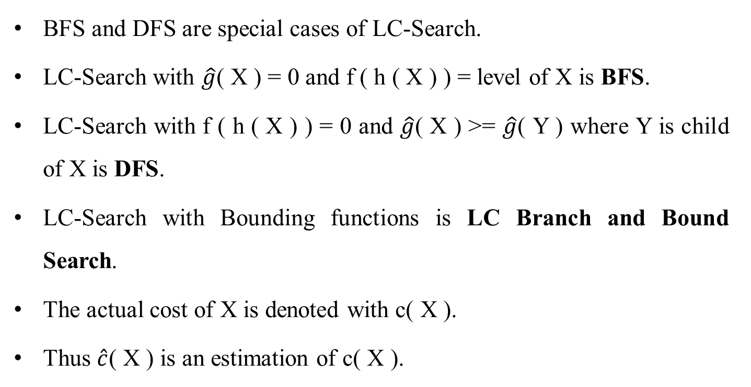
LC-Search (Contd..)
BFS and DFS are special cases of LC-Search.
LC-Search with $\hat{g}$( X ) = 0 and f ( h ( X ) ) = level of X is BFS.
LC-Search with f ( h ( X ) ) = 0 and $\hat{g}$( X ) >= $\hat{g}$( Y ) where Y is child of X is DFS.
LC-Search with Bounding functions is LC Branch and Bound Search.
The actual cost of X is denoted with c( X ).
Thus $\hat{c}$( X ) is an estimation of c( X ).

Slide 6
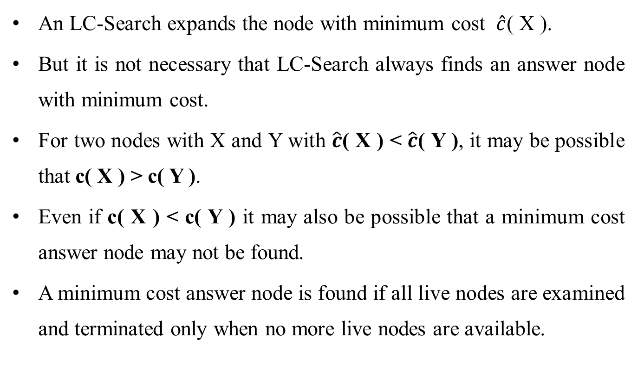
LC-Search (Contd..)
An LC-Search expands the node with minimum cost $\hat{c}$( X ).
But it is not necessary that LC-Search always finds an answer node with minimum cost.
For two nodes with X and Y with $\hat{c}$( X ) < $\hat{c}$( Y ), it may be possible that c( X ) > c( Y ).
Even if c( X ) < c( Y ) it may also be possible that a minimum cost answer node may not be found.
A minimum cost answer node is found if all live nodes are examined and terminated only when no more live nodes are available.

Slide 7
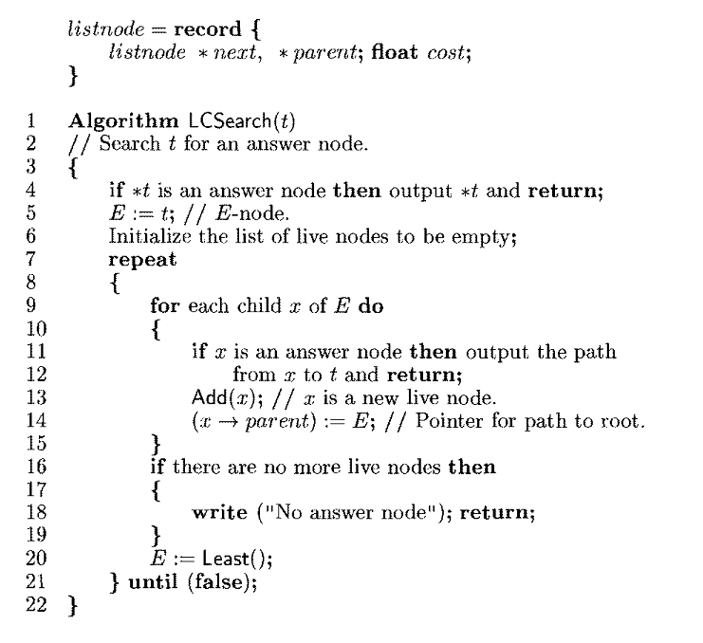
Control abstractions for LC-search

Slide 8
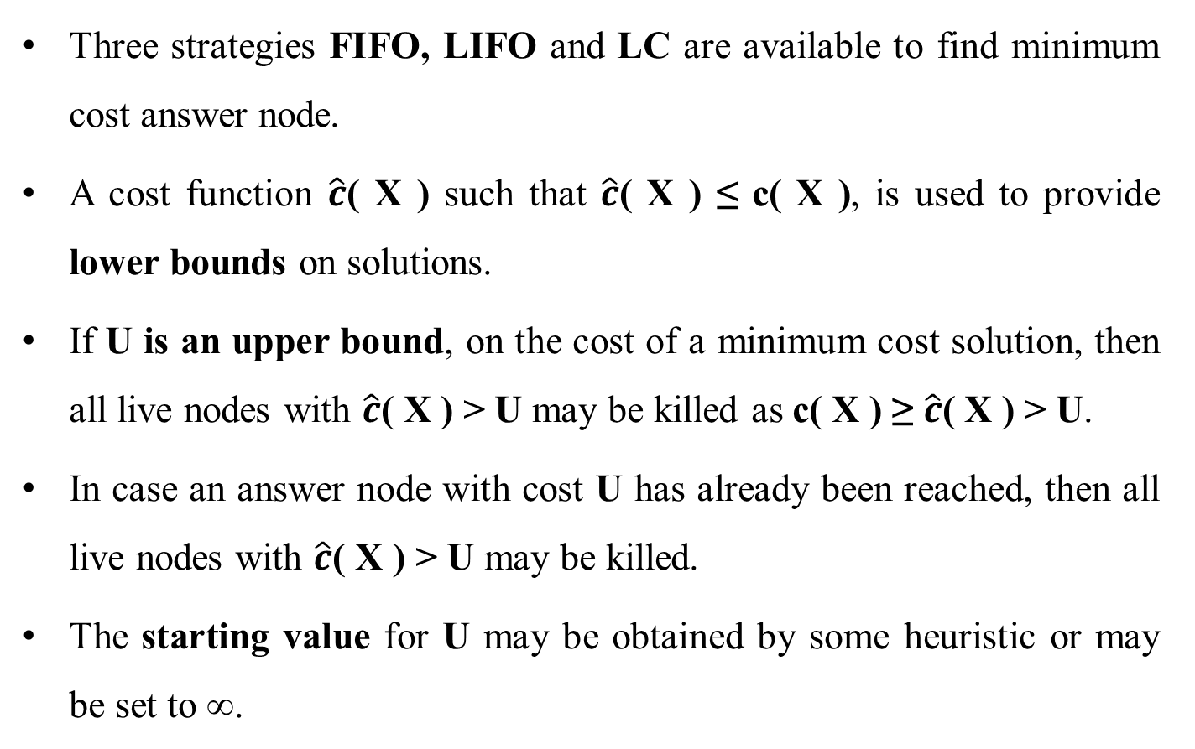
Bounding
Three strategies FIFO, LIFO and LC are available to find minimum cost answer node.
A cost function $\hat{c}$( X ) such that $\hat{c}$( X ) ≤ c( X ), is used to provide lower bounds on solutions.
If U is an upper bound, on the cost of a minimum cost solution, then all live nodes with $\hat{c}$( X ) > U may be killed as c( X ) ≥ $\hat{c}$( X ) > U.
In case an answer node with cost U has already been reached, then all live nodes with $\hat{c}$( X ) > U may be killed.
The starting value for U may be obtained by some heuristic or may be set to ∞.

Slide 9
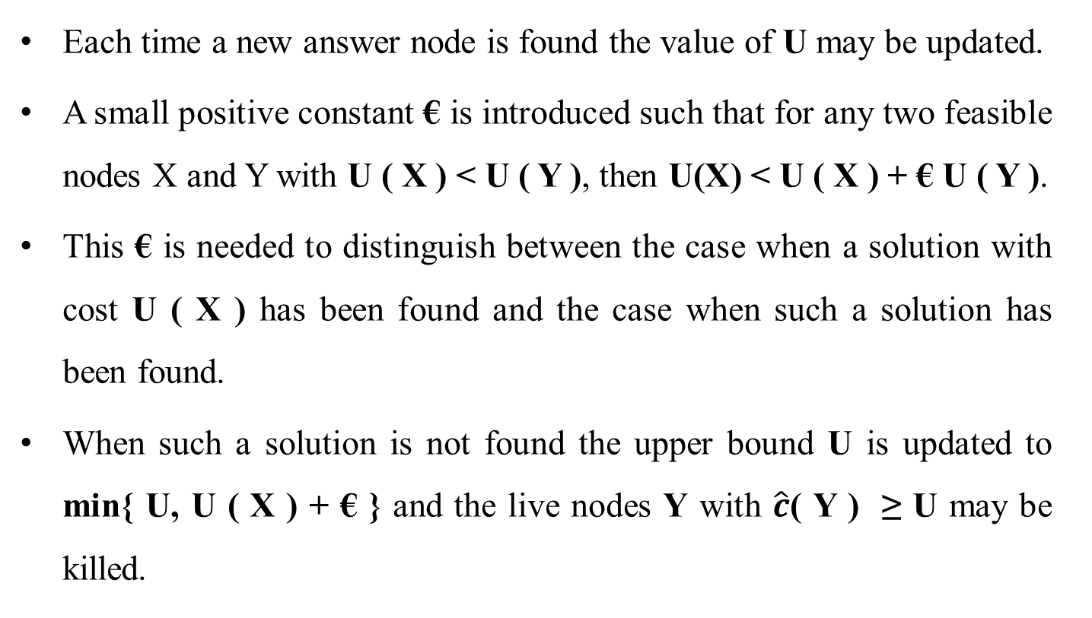
Bounding (Contd..)
Each time a new answer node is found the value of U may be updated.
A small positive constant € is introduced such that for any two feasible nodes X and Y with U ( X ) < U ( Y ), then U(X) < U ( X ) + € U ( Y ).
This € is needed to distinguish between the case when a solution with cost U ( X ) has been found and the case when such a solution has been found.
When such a solution is not found the upper bound U is updated to min{ U, U ( X ) + € } and the live nodes Y with $\hat{c}$( Y ) ≥ U may be killed.

Slide 10
Bounding (Contd..)
This does not kill the node that promised to lead to a solution with value ≤ U.
Branch & Bound algorithms can be applied to optimization problems.
We only deal with minimization problems, because a maximization problem is easily converted into a minimization problem by changing the sign of the objective function.
Searching for an optimal solution is equivalent to searching for a least cost answer node.

Slide 11
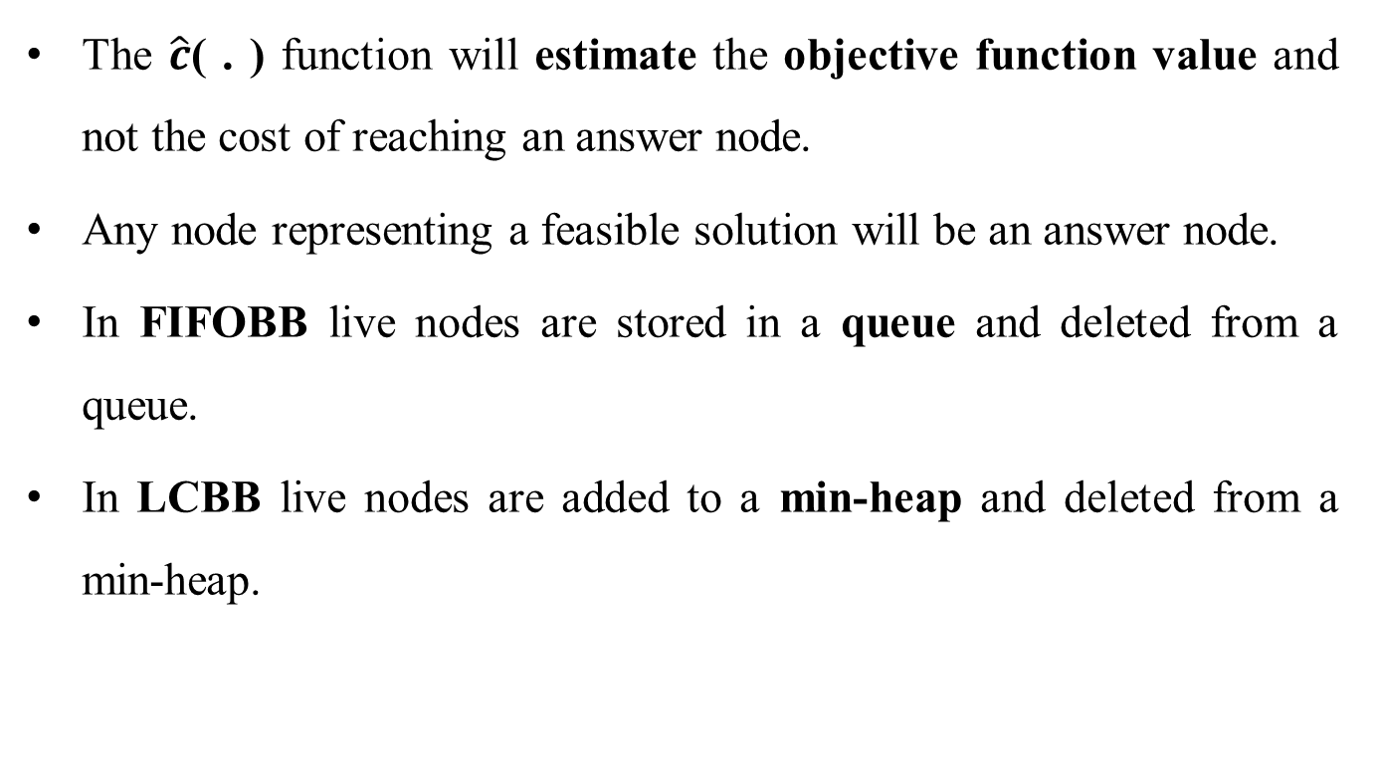
Bounding (Contd..)
The $\hat{c}$( . ) function will estimate the objective function value and not the cost of reaching an answer node.
Any node representing a feasible solution will be an answer node.
In FIFOBB live nodes are stored in a queue and deleted from a queue.
In LCBB live nodes are added to a min-heap and deleted from a min-heap.

Slide 12
How to expand the tree?
By the best-first search scheme
That is, by expanding the node with the best lower bound.
If two nodes have the same lower bounds, expand the node with the lower upper bound.

Slide 13
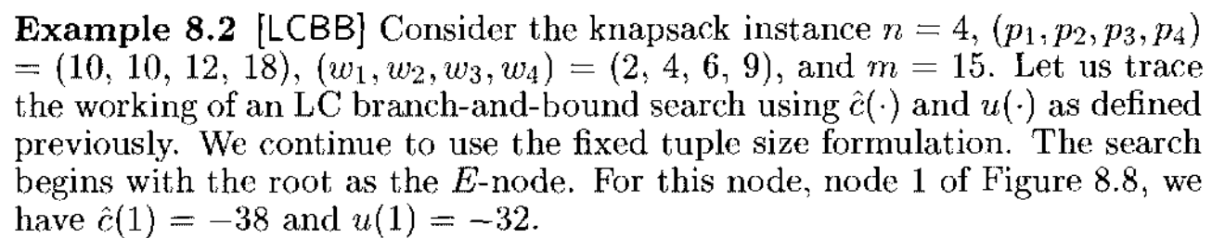
0/1 Knapsack

Slide 14
